Slide 1



QA בודק תוכנה
אלכס גורבצ'וב

Slide 2
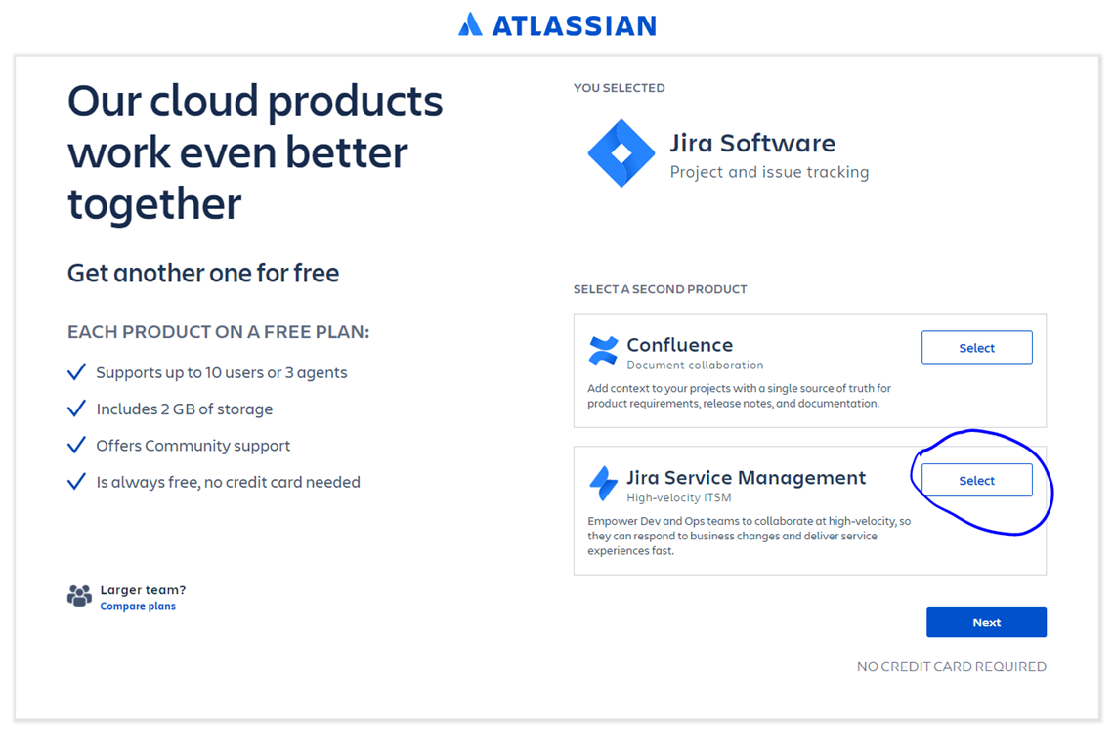
Jira
Jira - Installation
https://www.atlassian.com/software/jira

Slide 3
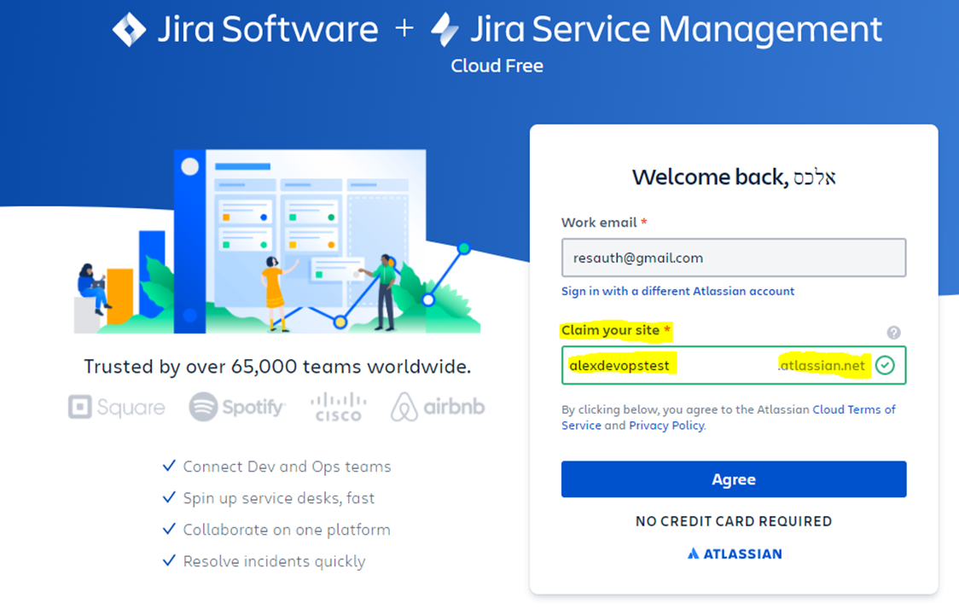
Jira
Jira - Installation
https://www.atlassian.com/software/jira
שם חברה

Slide 4
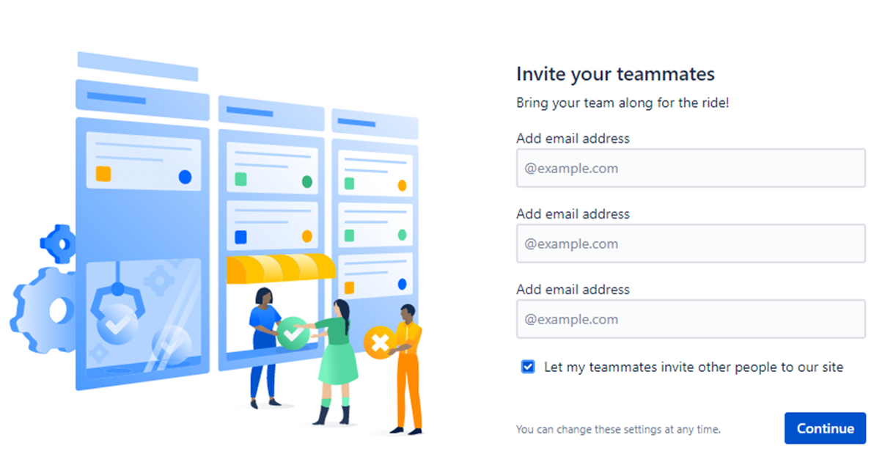
Jira
Jira - Installation
https://www.atlassian.com/software/jira

Slide 5
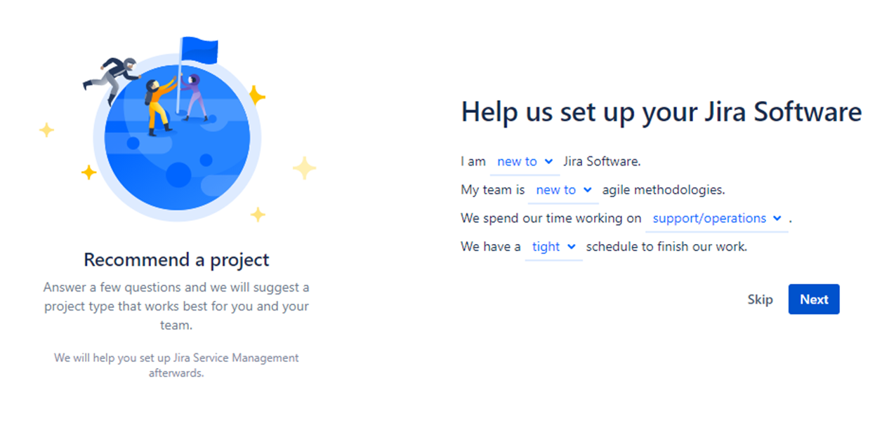
Jira
Jira - Installation
https://www.atlassian.com/software/jira

Slide 6
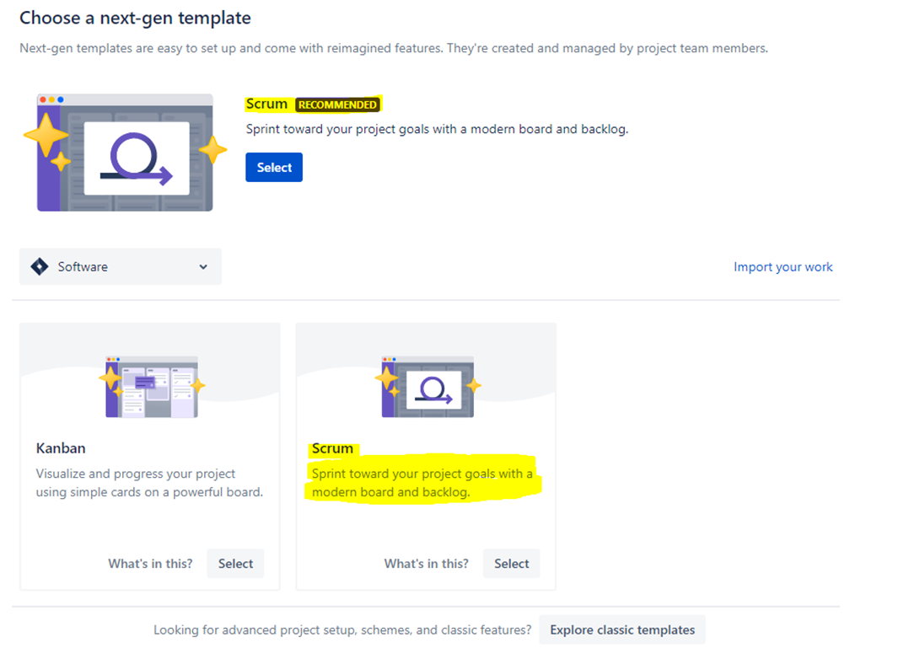
Jira
Jira - Installation
https://www.atlassian.com/software/jira

Slide 7
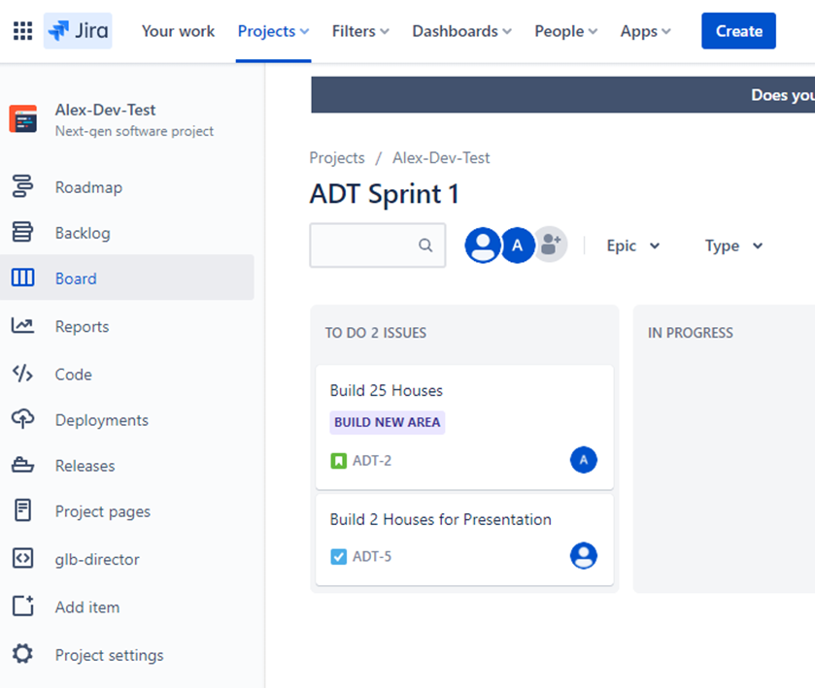
Jira
Jira - Installation
https://www.atlassian.com/software/jira
Scrum
Roadmap
Backlog
Board
Reports
Code
Deployments
Releases
Project Pages
Project Settings

Slide 8

שאלות?

